Slide 1



Web programming with JS(2)
By Elham Jaffar

Slide 2
Recapping JavaScript

Slide 3

Overview
ECMAScript (ES) is a scripting language specification standardized by ECMAScript International. It is used by applications to enable client-side scripting. Languages like JavaScript, Jscript and ActionScript are governed by this specification.
You have to start using let and const instead of var

Slide 4
ES6?
To remove unnecessary repetition in your code.
WHY?
By removing unnecessary repetition, your code becomes easier to read and more concise.
HOW?
By using new shorthand ways for initializing objects and adding methods to objects.

Slide 5
Variable
*All variables are "hoisted”
There are issues associated with variables declared with var
function newFunction() {
var hello = "hello";
}
console.log(hello); // error: hello is not defined
Variables are accessible within same block ONLY!
Variables can be re-declared and updated
WITH NO ERROR!
var greeter = "hey hi";
var greeter = "say Hello instead";

Slide 6
More about Variable
Do you remember Hoisting?
Hoisting is a JavaScript mechanism where variables and function declarations are moved to the top of their scope before code execution.
console.log (greeter);
var greeter = "say hello”;
Declarations are Hoisted
Initializations are Not Hoisted
BUT ! it is interpreted
var greeter;
console.log(greeter); //greeter is undefined
greeter = "say hello"

Slide 7
Let and Const
Because of all issues associated with variables declared with var, we need new way to define variables.
Let:
It is a block scoped.
It can be updated but not re-declared.
Const:
It maintains constant values.
Const declarations are block scoped
It cannot be updated or re-declared
-From now, let’s use Let & Const

Slide 8
concat() Method
The concat() method is used to join two or more arrays
SYNTAX:
array1.concat(array2, array3, ..., arrayX)
Let’s try something:
let color = [”blue",”yellow",”red"];
let color2 = [”white",”black"];
console.log(color + color2);
cosole.log(color.concat(color2));
?
Is there a difference

Slide 9
Template Literals
SYNTAX:
NOTE:
It is (back-tick)
`string text`
`string text line 1 string text line 2`
`string text ${expression} string text`
tag `string text ${expression} string text`
External Resource !

Slide 10
Template Literals - HTML
const person = {
name: 'Wes', job: 'Web Developer', city: 'Hamilton', bio: 'Wes is a really cool guy that loves to teach web development!'
}
// And then create our markup:
const markup = `
<div class="person">
<h2> ${person.name} </h2>
<p class="location">${person.location}</p>
<p class="bio">${person.bio}</p>
</div> `;

Slide 11
Destructuring
Destructuring borrows inspiration from languages like Perl and Python by allowing you to specify the elements you want to extract from an array or object on the left side of an assignment.
Example: const point = [10, 25, -34];
const [x, y, z] = point;
console.log(x, y, z);

Slide 12
Destructuring
Object
const mobile = {
type: iphone',
color: ’gold',
storage: 128
};
const {type, color, storage} = mobile;
console.log(type, color, storage);
Array
const point = [15, 25, 35];
const [x, y, z] = point;
console.log(x, y, z);

Slide 13
Object Literal shorthand
Another way
let type = iphone';
let color = ‘gold’;
let storage= 128;
const mobile = {
type: type,
color: color,
storage : storage
};
console.log(gemstone);

Slide 14
For ... IN
for..in is a method for iterating over "enumerable" properties of an object.
The for..in method provides us the most straightforward way to loop over Object keys and values, since Objects do not have access to the forEach method that Arrays do.
const obj = { a: 1, b: 2, c: 3, d: 4 }
for (const key in obj) {
console.log( obj[key] );
}
// Result: 1, 2, 3, 4

Slide 15
For ... OF
It is a loop that works well with Arrays and Strings, as they are iterable. This method is a more reliable way of looping through an Array in sequence.
const array = ['a', 'b', 'c', 'd'];
for (const item of array) {
console.log(item)
}
// Result: a, b, c, d
const string = 'Ire Aderinokun';
for (const character of string) {
console.log(character)
}
// Result: I, r, e, , A, d, e, r, i, n, o, k, u, n

Slide 16
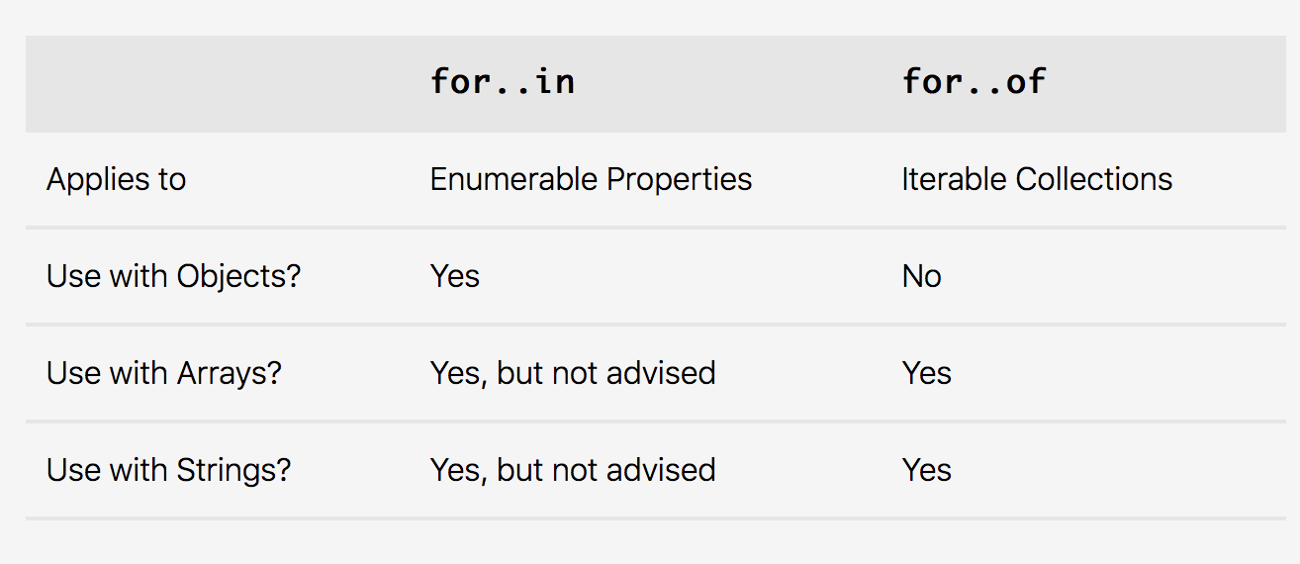
For ... In Vs For … of

Slide 17
Continue & Break
break → jump out of a loop.
The break statement breaks the loop and continues executing the code after the loop (if any)
continue → breaks one iteration (in the loop), if a specified condition occurs, and continues with the next iteration in the loop.

Slide 18
Spread operator
It written with three consecutive dots ( ... ), is new in ES6 and gives you the ability to expand, or spread, iterable objects into multiple elements.
Let’s try this:
const books = ["Don Quixote", "The Hobbit", "Alice in Wonderland", "Tale of Two Cities"];
console.log(...books);
console.log(books);

Slide 19
Spread operator
Let’s try
/* * Instructions: Use the spread operator to combine the `fruits` and `vegetables` arrays into the `produce` array. */ const fruits = ["apples", "bananas", "pears"]; const vegetables = ["corn", "potatoes", "carrots"]; const produce = [...fruits,...vegetables];
const produce2 = fruits + vegetables;
const produce3 = fruits.concat(vegetables);
console.log(produce);
console.log(produce2);
console.log(produce3);

Slide 20
Rest parameter
The rest parameter, also written with three consecutive dots ( ... ), allows you to represent an indefinite number of elements as an array. This can be helpful in a couple of different situations.
For example: When assigning the values of an array to variables.
const order = [20.17, 18.67, 1.50, "cheese", "eggs", "milk", "bread"]; const [total, subtotal, tax, ...items] = order; console.log(total, subtotal, tax, items); //prints: 20.17 18.67 1.5 ["cheese", "eggs", "milk", "bread"]
Notes:
Use this exmaple:
https://classroom.udacity.com/nanodegrees/nd001/parts/a76bb181-979a-4b36-b32f-01bced6e363e/modules/4116dc31-6d06-4774-b082-d60ca0980d2b/lessons/42383e89-ac6a-491a-b7d0-198851287bbe/concepts/6a6c5deb-2f06-4cd7-afab-222716634f10

Slide 21
shall workshop

Slide 22
Windows or Mac ?
Do you know how to open terminal/command line?
If you are using:
Linux and Mac → no need to install shall
Windows → install GIT bash

Slide 23
Commands
We will try the most popular once
Click Here!

Slide 24
Things you can do In Shall
Install Program
Run Program
Command Line Interface
Manage Directories and files
Analyze data
And more !

Slide 25
version control

Slide 26
version control
What is version control?
Version control systems are a category of software tools that help a software team manage changes to source code over time. Version control software keeps track of every modification to the code in a special kind of database.
Examples:
Subversion & GIT
There are two main types of version control system models:
Centralized model - all users connect to a central, master repository (online)
Distributed model - each user has the entire repository on their computer (offline)

Slide 27
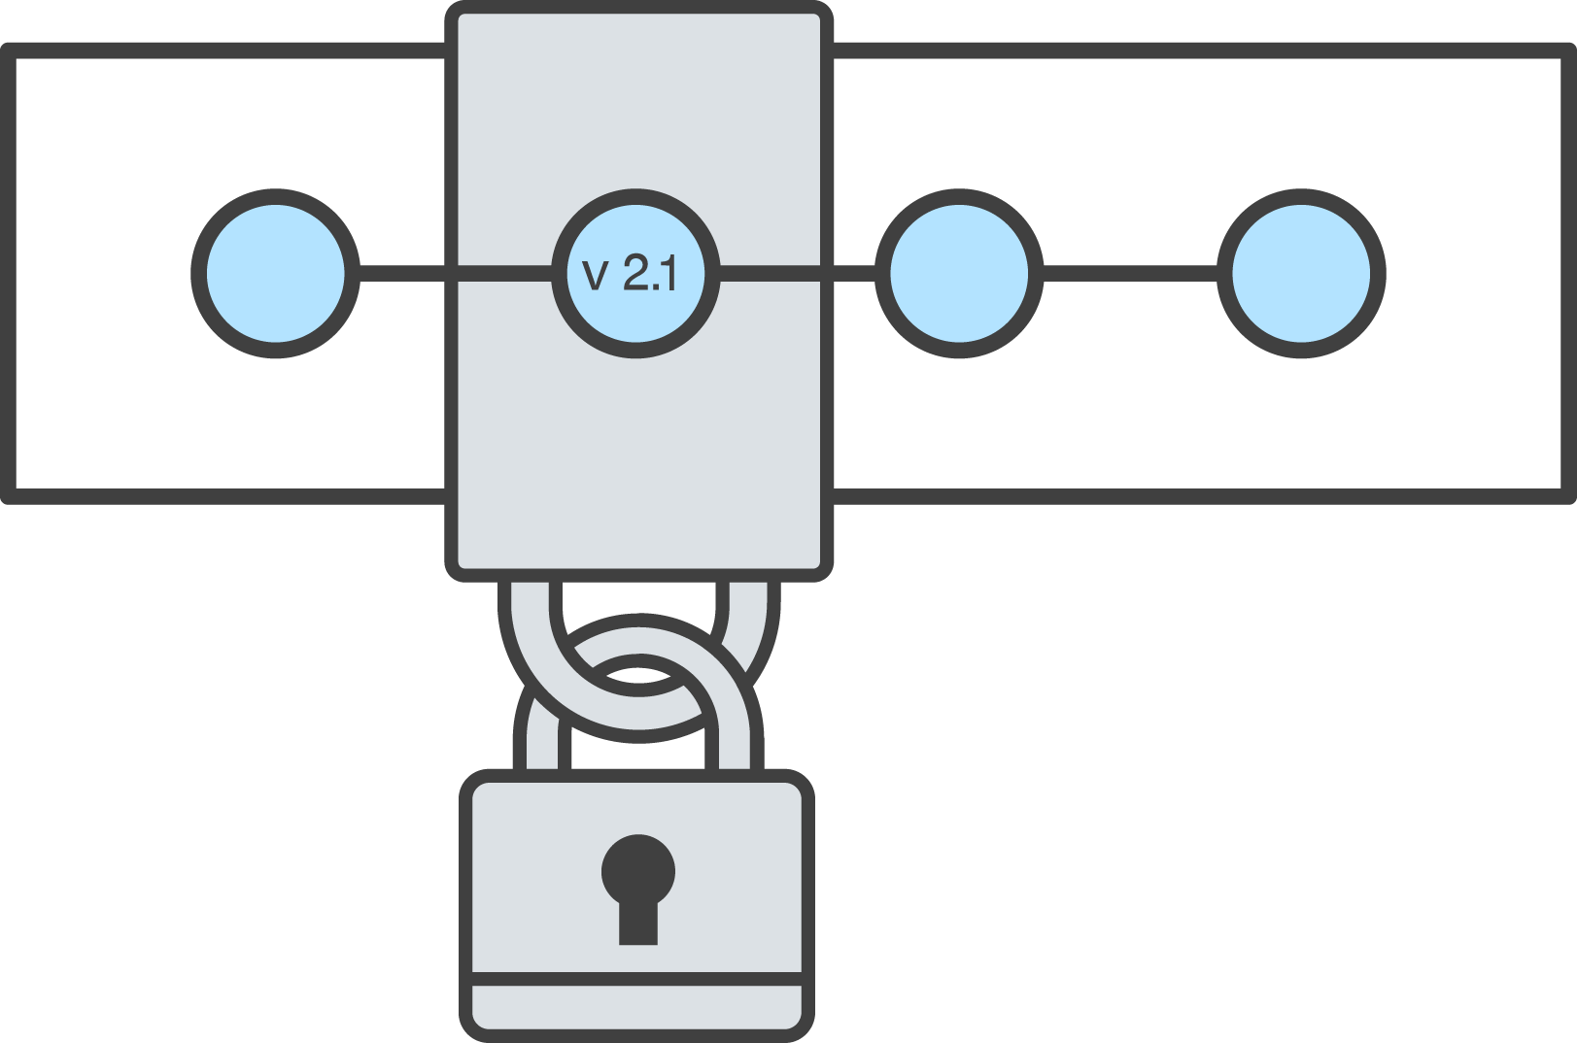
Why version control?
The ability to label a change
The ability to give a detailed explanation of why a change was made
The ability to move between different versions of the same document
The ability to undo change A, make edit B, then get back change A without affecting edit B

Slide 28

GIT Vs GitHub
GitHub is a web-based hosting service for version control using git.

Slide 29
Download Or Update Git
https://git-scm.com/download/
Check the version: git --version

Slide 30
Configure Git (Name & Editor)
How?? Click Here !

Slide 31
Terminology
Check this file !

Slide 32
Git Commands (1)
git init → Create an empty Git repository or reinitialize an existing one
git clone → Clone a repository into a new directory
git status → Show the working tree status
git log → Show commit logs (to view specific commit use → git log -p fdf5493)

Slide 33
Git Commands (2)
git add → Add file contents to the index
git commit→ Record changes to the repository
git diff→ Show changes between commits, commit and working tree, etc

Slide 34
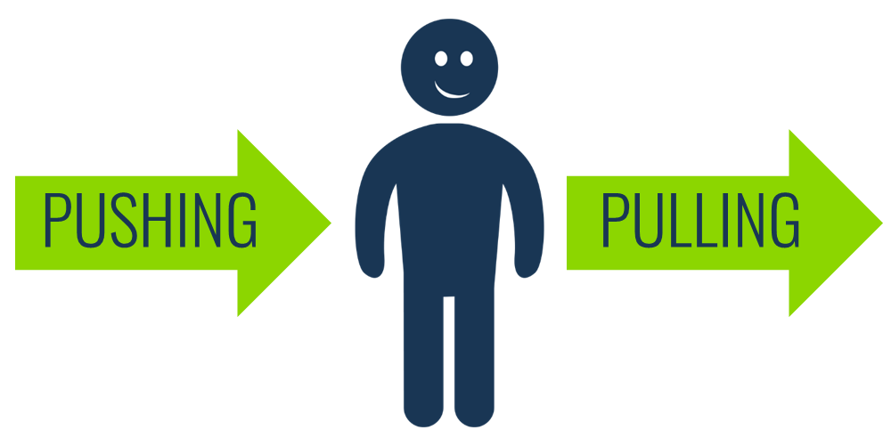
Git Pull & Git Push
git pull → Incorporates changes from a remote repository into the current branch.
git push → Update remote refs along with associated objects

Slide 35
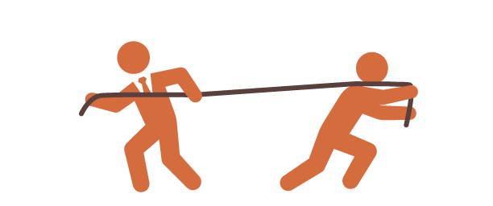
Merge & Merge Conflict

Slide 36
Other git command
Use the Documentation !

Slide 37
Recapping README.md

Slide 38
Document Object Model

Slide 39
DOM
It is a tree-like structure that is a representation of the HTML document, the relationship between elements, and contains the content and properties of the elements.
The DOM is not:
Part of the JavaScript language
The DOM is:
Constructed from the browser
It is globally accessible by JavaScript code using the document object

Slide 40
Select An Element In JS
Select an element
ID
documents.getElementByID();
Class Name documents.getElementByClassName();
Tag
documents.getElementByTag();

Slide 41
HTML DOM querySelector() Method
The querySelector() method returns the first element that matches a specified CSS selector(s) in the document.
Examples:
document.querySelector("p");
document.querySelector("#demo").innerHTML = "Hello World!";

Slide 42
HTML DOM querySelectorAll() Method
The querySelectorAll() method returns all elements in the document that matches a specified CSS selector(s)

Slide 43
Create Elements
createElement() → creates an Element Node with the specified name
appendChild() → add a child element to a parent element as its last child
createTextNode() → create a text node
insertAdjacentHTML() → put HTML text anywhere around an element

Slide 44
Remove Elements
.removeChild() → method removes a specified child node of the specified
.remove() → method removes the object from the tree it belongs to
Note that: .removeChild() must be called on the parent of the element being removed and must be passed the child to be removed, while .remove() can be called directly on the element to delete.

Slide 45
Change Input
.innerHTML → property sets or returns the HTML content (inner HTML) of an element.
.outterHTML() → property describes the element including its descendants.

Slide 46
Would you like to learn jQuery?

Slide 47
jQuery
jQuery is a lightweight, "write less, do more", JavaScript library.
jQuery also simplifies a lot of the complicated things from JavaScript, like AJAX calls and DOM manipulation.

Slide 48
How to use jQuery?
Download the jQuery library from jQuery.com
Add this line to your html file <script src="jquery-3.3.1.min.js"></script>
OR
Use it directly from Content Delivery Network
<scriptsrc="https://ajax.googleapis.com/ajax/libs/jquery/3.3.1/jquery.min.js"></script>

Slide 49
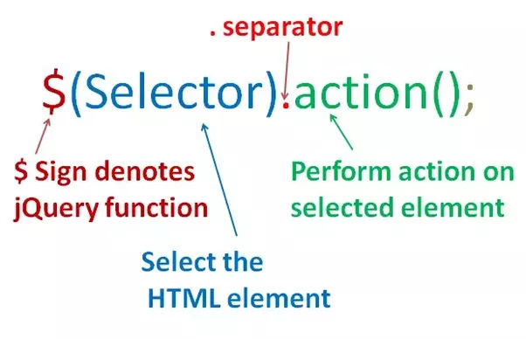
jQuery Syntax
jQuery selectors allow you to select and manipulate HTML element(s)

Slide 50
Dom Exercise
Create a HTML form that has 2 fields and submit button:
1- First Name
2- Second Name
3- Submit Button
Then write a JavaScript function called it (getFormValue()) to get the values of First and Last name when the user click on Submit.
Show the result as alert or on console !
Notes:
https://www.w3resource.com/javascript-exercises/javascript-dom-exercise-2.php

Slide 51

Remember that we are here to help you
All you have to do is ASK!
Thank you for Attending

